Slide 1
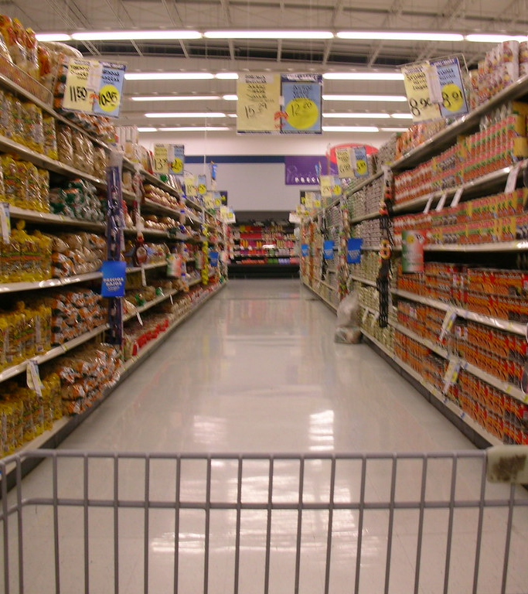
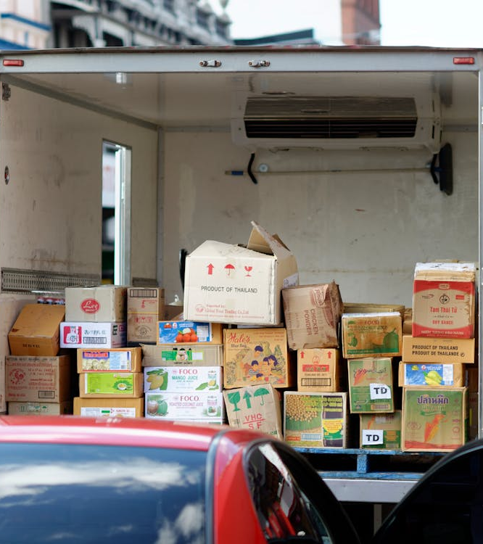
AtliQ Mart - Supply Chain Analysis

Slide 2

Problem Statement
AtliQ Mart is a growing FMCG manufacturer headquartered in Gujarat, India. It is currently operational in three cities Surat, Ahmedabad and Vadodra. They want to expand to other metro/tier1 cities in the next 2 years.
AtliQ Mart is currently facing a problem where a few key customers did not extend the annual contract due to service issues. It is speculated that some of the essential products were either not delivered on time or not delivered in full over a continued period, which could have resulted in bad customer service. Management wants to fix this issue before expanding to other cities and requested their supply chain analytics team to track the ’On time’ and ‘In Full’ delivery service level for all the customers on a daily basis so that they can respond swiftly to these issues.
The Supply Chain team decided to use a standard approach to measure the service level in which they will measure ‘on-time delivery (OT) %’, ‘In-full delivery (IF) %’ and OnTime in full (OTIF) % of the customer orders on a daily basis against the target service level set for each customer.

Slide 3
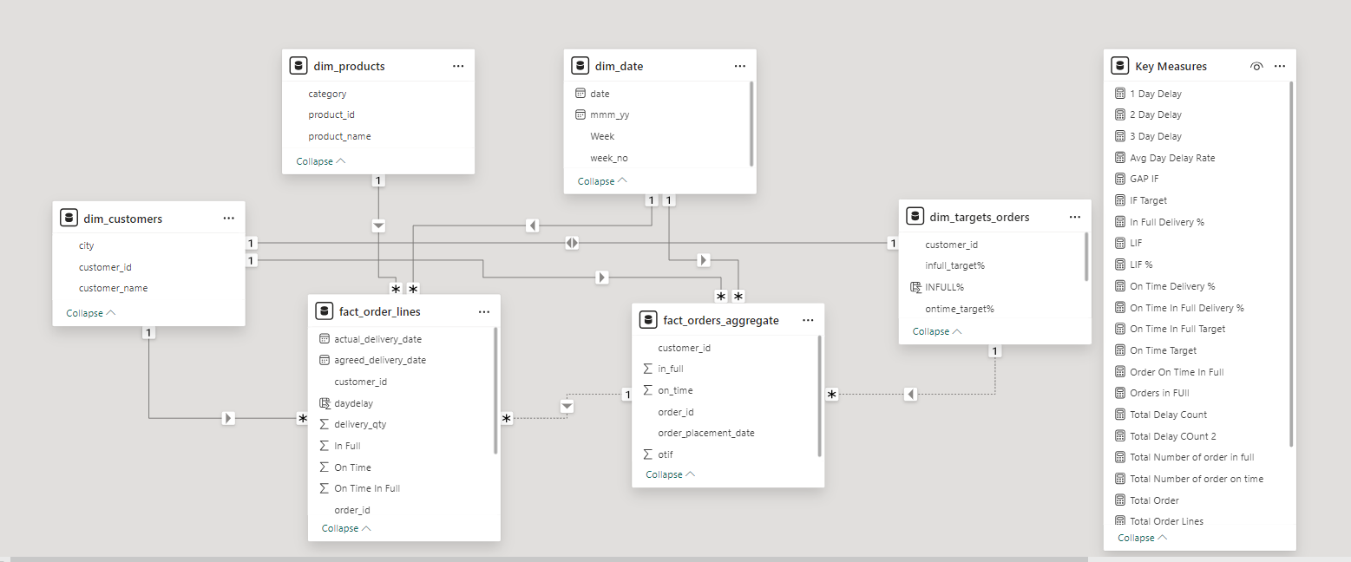
Data Model

Slide 4

Metrics
Total Order Lines Count of all order lines in fact_orders table
On Time Delivery % Number of orders delivered On Time / Total Number of Orders
In Full Delivery % Number of orders delivered in Full quantity / Total Number of Orders
On Time In Full % Number of orders delivered both IN Full & On Time / Total Number of Orders
Line Fill Rate Number of order lines shipped In Full Quantity / Total Order Lines
Volume Fill Rate Total Quantity shipped / Total Quantity Ordered
Total Orders Total Quantity Ordered
On Time Target Average of On-Time Target
In Full Target Average of In-Full Target
On Time In Full Target Average of OTIF Target

Slide 5
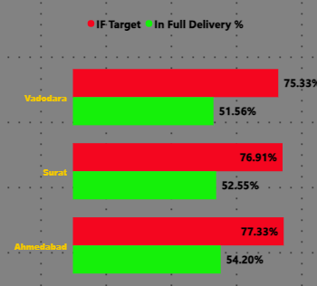
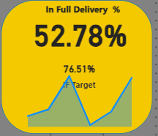
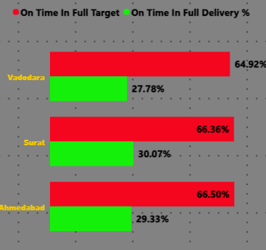
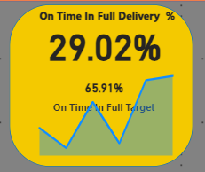
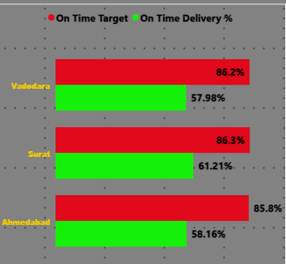
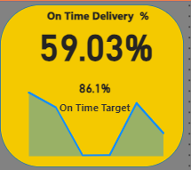
KPI’s Analysis
All the Key Metrics (OT%, IF%, OTIF%) are far behind the target in all the cities and our stores in Vadodara are behind the overall average across sites .
Vadodra On time Delivery % is 36% less than the target and even less than the overall average of 29%
Vadodra In Full Delivery % is 24% less than the target and even less than the overall average of 52%

Slide 6
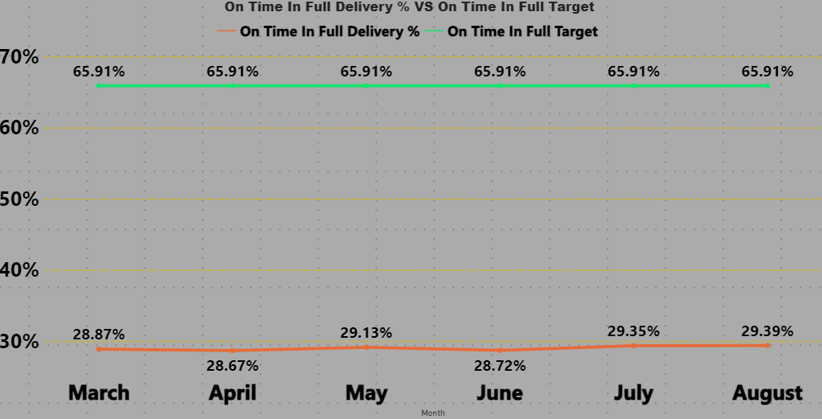
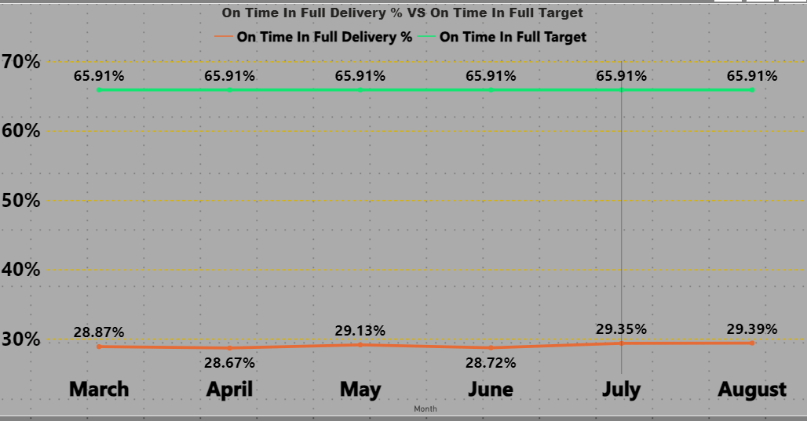
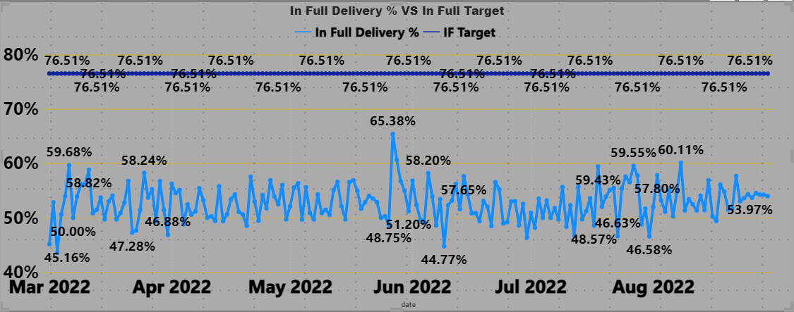
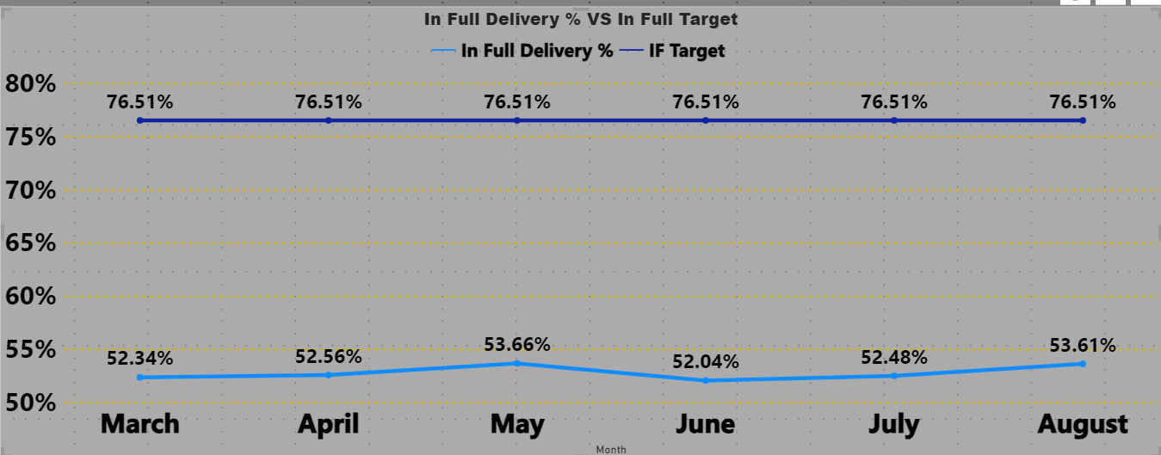
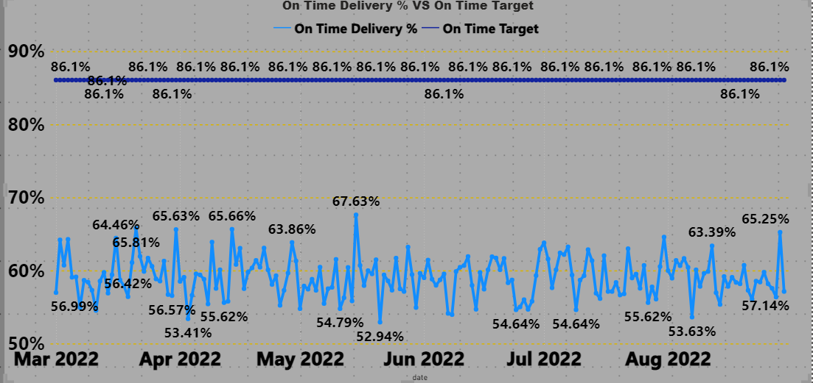
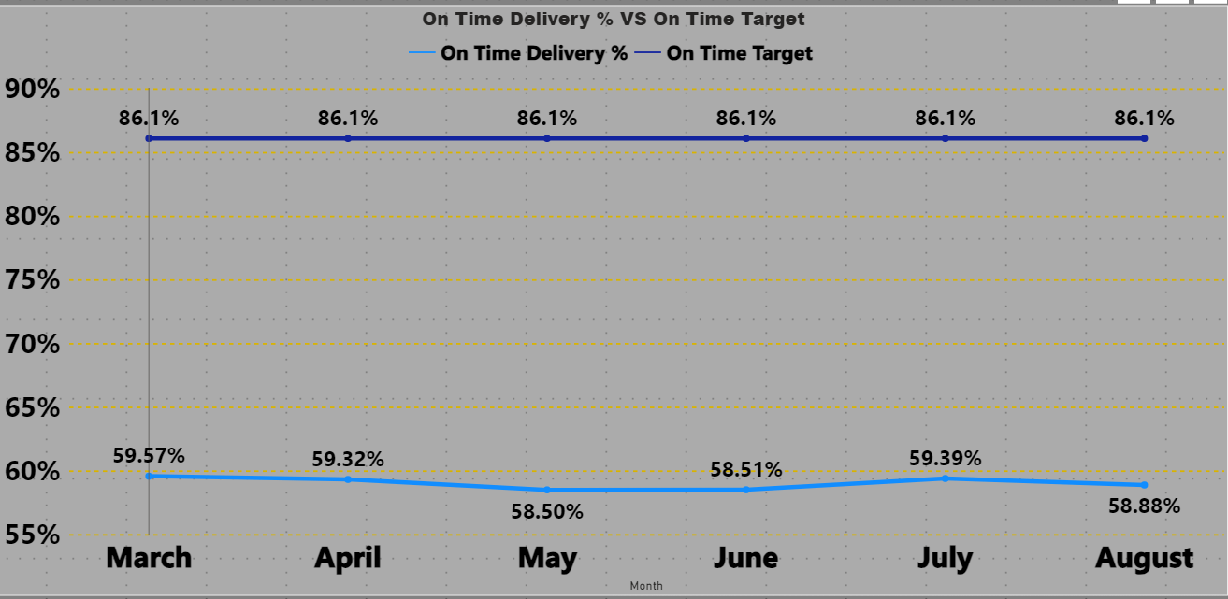
Daily & Monthly Analysis
MAY'22 and AUG'22 are the two months where IF% and OTIF 9%have shown slight improvement compare to past month, still they are far away from Target levels
In Daily Trend for OT% Graphs for Order even Daily level of OT% too are significantly lower than Targeted OT%
As we see in above slide only 59.03% of total orders are delivered on time
Even Daily trends of IF% and OTIF % chartshows that not a single day they are able totouch the Target lines for respective matrices.Especially OTIF% performance is quitedisappointing.

Slide 7
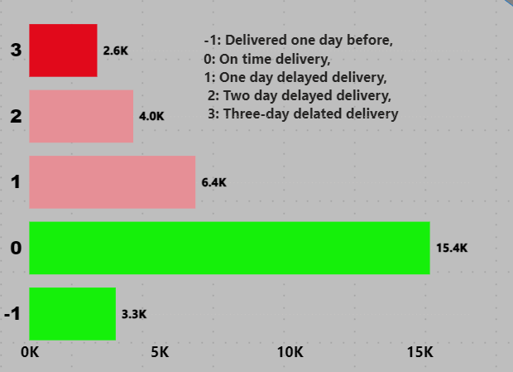
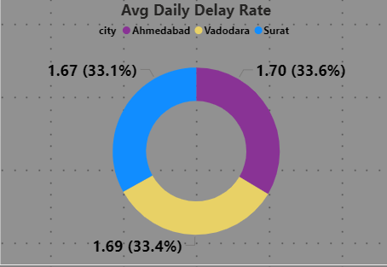
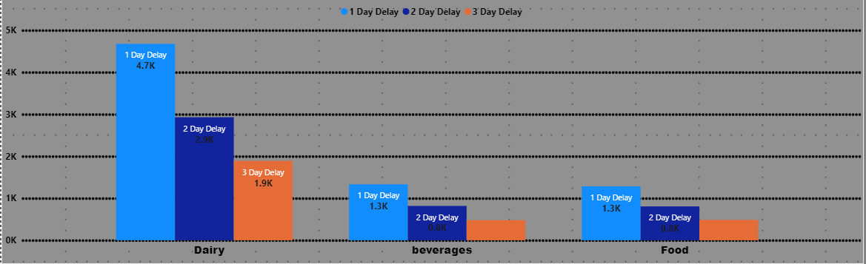
`
Delayed Delivery Analysis
13000 Orders has been delivered late from the agreed delivery date.
On an average, Orders getting delayed1.69days to be delivered from the agreed delivery date
Dairy Products Contribute highest in average delayed days , when we do the product level analysis we find Ghee, curd and butter products are most delayed to deliver.
Lotus Mart, Coolblue, Acclaimed stores have the highest orders as well as delayed the most to deliver the products on time

Slide 8
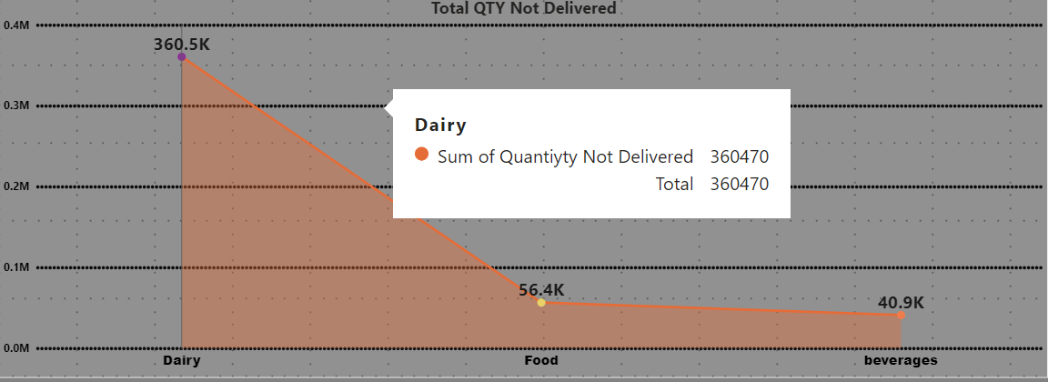
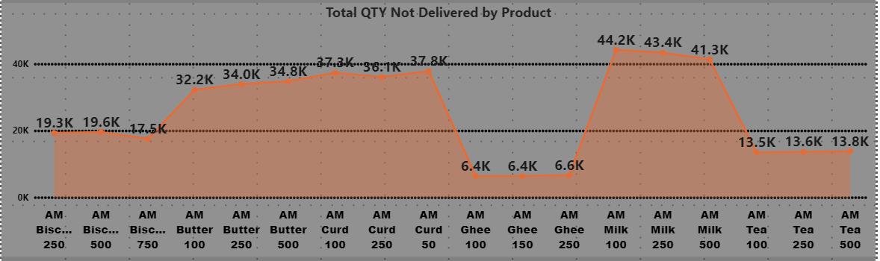
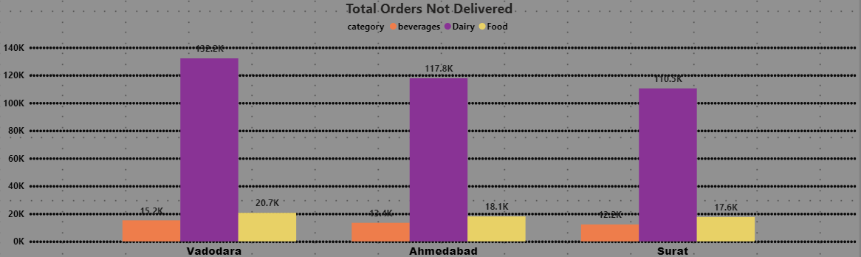
Quantity Ordered Not Delivered
Total 458K Quantities were short to be delivered and in result not delivered to customer which means we are not analyzing the items to be kept in stock to meet the demand
We can see Dairy products top the chart in term of deficit of quantity to be delivered .
we can see Milk , Curd & Butter products are most found to be short in stock .
Analyzing the same on city level shows that we are facing the same situation in all the cities but vadodra is most impacted .

